Slide 1
khzth;fspd; MSik tsh;r;rpapy; Mrphpah;fspd; gq;fspg;G
ROLE OF TEACHERS IN DEVELOPING STUDENTS
PERSONALITY
Dr.T.Sivasakthi Rajammal
Department of Educational Psychology
Tamil Nadu Teachers Education University
Chennai – 97.

Slide 2
MSik vd;why; vd;d? What is Personality?
MSik vd;gJ
cly; (Physical)
kdk; (Mental)
czh;r;rp kdg;ghd;ik (Emotinal attitudes)
kjpg;Gfs; (Values)
Mh;tq;fs; (Interest) kw;Wk;
Cf;ff; fhuzq;fs; (Motivational factors)
,tw;wpd; nkhj;jj;njhFg;ghFk;.”

Slide 3
MSik tsh;r;rp vd;why; vd;d? What is Personality Development?
MSik tsh;r;rp vd;gJ,
“jd;idj; jhNd Ms;tJk;,
gpwiu MSk; ty;yikiaAk; ngWtJ”

Slide 4
1. Kd;khjphpia Cf;Ftpj;jy; (Encourage role Model)
Neh;kiwahd vz;zk; cilath;fis Kd;khjphpahf Kd;dpiyg;gLj;Jjy;.
mwptpay; (Science)
,yf;fpak; (Literature)
tuyhW (History)
fiy (Arts)

Slide 5
khzth;fspd; MSik tsh;r;rpapy; Mrphpah;fspd; gq;fspg;G
Kd;Diu (Introduction)
gs;sp – Mrphpah;, khzth;, MSik tsh;r;rp
MrphpaUf;F rthy;
khztUf;F kpfg;nghpa tha;g;G
KO MSik – gs;sp Kf;fpag;gq;F
Rje;jpuk;, khpahij kw;Wk; ,uf;fj;ij fw;Wj;jUjy;
ngw;NwhUf;F mLj;j epiy
Mrphpah; Kd; khjphp
gs;sp KbtpYk; xOf;fk; kw;Wk; epajp filg;gpbj;jy;;

Slide 6
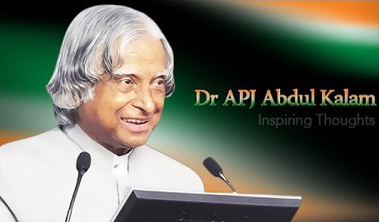
mwptpay; (Science)

Slide 7
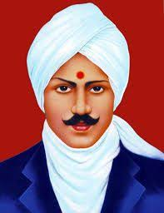
,yf;fpak; (Literature)

Slide 8
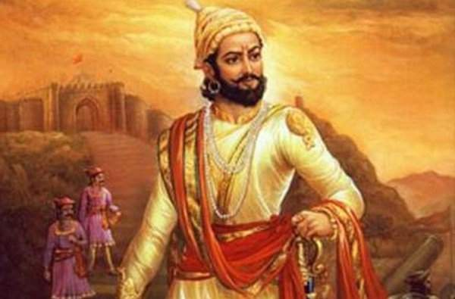
tuyhW (History)

Slide 9

fiy (Arts)

Slide 10
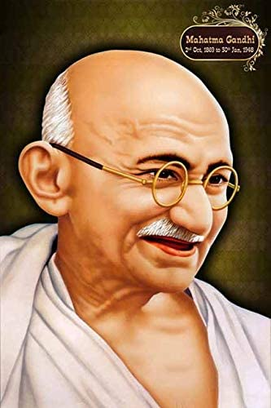
jiyth;fs; (Leaders)

Slide 11
Kd;khjphpia Cf;Ftpj;jy; (Encourage role Model)
khzth;fs;
jq;fSila elj;ij gz;Gfis Kd;khjphpNahL xg;gpLjy;
fijfs; kw;Wk; ehlfj;jpid cUthf;Fjy;
jdpj;jd;ikf;F Vw;whh;Nghy; Kd; khjphp jiyth;fis Njh;e;njLj;jy;

Slide 12
2. gz;Gfis Nkk;gLj;Jjy; (Character Building)
,sikapNyNa rpwe;j gz;Gfis cl;nrYj;Jjy;
Neh;kiwahd nray; cUthf;Fjy;
khzth;fis Cf;Ftpj;jy;
fUj;Jf;fis tpthjpf;fr; nra;jy;

Slide 13
fPo;f;fz;l gz;Gfs; xt;nthU jdpg;gl;l khzth;fspd; MSik Nkk;ghl;L tsh;r;rpf;F Jhz;fshf mikfpd;wd.
khpahij (respect)
guhkhpg;G (care)
nghWg;G (responsibility)
Neh;ik (fairness)
ek;gfj;jd;ik (trustworthiness)
ijhpak; (courage)
tplhKaw;rp (diligence)
xUikg;ghL (Integration)

Slide 14
3. Fwpf;Nfhs;fis tFj;Jf; nfhs;Sjy; kw;Wk; xOf;fj;ij Nkk;gLj;Jjy; (Set Principals & Discipline)
tFg;giwapy; ele;Jnfhs;s Ntz;ba gz;Gfisg; Nghjpj;jy;
gs;sp tshfj;jpy; vtw;iw nra;a Ntz;Lk;, nra;af;$lhJ
Fwpj;jNeuj;jpy; Ntiyia Kbj;jy;, Neue;jtwhik
rpwe;j gz;Gs;s khzth;fspd; Fzeyd;fis ghuhl;Ljy;.

Slide 15
4. jd;dk;gpf;if (Self-Confidence)
midj;Jf; Foe;ijfspd; tsh;r;rpf;Fk; Kf;fpakhdJ
tFg;giwapy; fUj;Jg;ghpkhw;w FO eltbf;iffis cUthf;Ftjy; .
khzth;fspd; ftdk;, ek;gpf;ifia mjpfhpj;jy;;

Slide 16
5. mDjhgj;jpwid Nkk;gLj;Jjy;; (Build Empathy)
,uf;f Fzk;,
fUiz,
kdpjhgpkhdk;
,sk; tajpNyNa cUthf;fp czur;nra;jy;
mDjhgk; nfhz;ltuh ePq;fs;?

Slide 17
1) ePq;fs; jhd; tFg;G yPlh;. rpy Nfs;tpfis fUk;gyifapy; vOjptpl;L, cq;fisnay;yhk; mjw;F gjpy; vOjr; nrhy;yptpl;L, rpwpJNeuk; ntspNa nrd;wpUf;fpwhh; Mrphpah;. xU khzth; mg;NghJ Jhq;fpf; nfhz;bUe;jhy; vd;d nra;tPh;fs;?
m) mtid vOg;gp Nfs;tpfSf;Fg; gjpy; vOjr; nrhy;Ntd;.
M) mtidj; njhlh;e;J Jhq;ftpl;L Mrphpah; te;jJk; fhl;bf; nfhLg;Ngd;.
,) Jhq;fl;Lk; ghtk; mtDf;F tPl;by; vd;d gpur;ridNah!

Slide 18
2) New;W jdf;F Neh;e;j xU epfo;it kpfTk; ePskhf tpthpf;fpwhd; xU ez;gd;. cq;fSf;F Nghubf;fpwJ. vd;d nra;tPh;fs;?
m) mtd; Nyrhf ,ilntsp tpLk;NghJ Ngr;ir khw;WNtd;.
M) “RUf;fkhfr; nrhy;” vd;W gspr;nrd;W $wptpLNtd;.
,) ftdkhff; Nfl;gJNghy; ebg;Ngd;.

Slide 19
3) gs;sp Mz;L tpohTf;fhf, rf khzth;fNshL Nrh;e;J xU FO ghlYf;F xj;jpif ghh;f;fpwPh;fs;. xU khztdpd; Fuy; kl;Lk; mbf;fb Nruhky; ];Ujp tpyfp xypf;fpwJ. vd;d nra;tPh;fs;?
m) mij ntspg;gLj;jpdhy;, rf khzthpd; kdk; Gz;gLk;. vdNt fz;L nfhs;shky; ,Ue;J tpLNtd;.
M) jdpikapy; rf khzthplk; vLj;Jr; nrhy;yp, Fiwghl;ilr; rhp nra;J nfhs;sr; nrhy;Ntd;.
,) me;j khztiu FOg; ghlypypUe;J tpyfptplr; nrhy;Ntd;.

Slide 20
4) fhiyapy; mg;ghNth, mk;khNth mYtyfj;Jf;Ff; fpsk;Gk;NghJjhd;, mthplk; ePq;fs; Nfl;Lg; ngw Ntz;ba xU tp\ak; epidTf;F tUfpwJ vd;d nra;tPh;fs;?
m) kpFe;j jaf;fj;Jld; mijf; Nfl;Ngd;.
M) me;j Neuj;jpy; mijnay;yhk; Nfl;lhy; ngw;NwhUf;F vt;tsT nld;\d;! nksdkhf ,Ue;J tpLNtd;.
,) ,ijnay;yhk; ghh;f;f KbAkh? chpikahf ehd; Nfl;fNtz;baij cldbahff; Nfl;Ngd;.

Slide 21
5) Nfhil tpLKiwapy; ngw;NwhUld; Xhplj;jpw;F Rw;Wyh nrd;W tUfpwPh;fs;. te;jTld; “vg;gb ,Ue;jJ Rw;Wyh?” vd;W ez;gh;fs; Nfl;fpwhh;fs;. mg;NghJ gf;fj;jpNyNa cq;fs; ngw;NwhUk; ,Uf;fpwhh;fs;. me;jr; Rw;Wyh cq;fs; vjph;ghh;g;Gf;Fj; jFe;j khjphpNah, RitahdjhfNth ,y;iy. cq;fs; gjpy; vd;dthf ,Uf;Fk;?
m) ngw;Nwhh; kdk; Gz;glf; $lhJ. vdNt ‘Rw;Wyh kpf ed;whf ,Ue;jJ’ vd;Ngd;.
M) “ehd; vjph;ghh;j;j khjphpNa ,y;iy. Vkhw;wk;jhd;” vd;W kdjpy; gl;lij kiwf;fhky; $wptpLNtd;.
,) “guthapy;iy. Mdhy; mLj;j jlit ,d;Dk; rpwg;ghd Rw;Wyhthf ,Uf;Fk;gb ghh;j;Jf; nfhs;Ntd;” vd;W $WNtd;.

Slide 22
6) [];f;hPk; filapy; Xh; [];f;hPik thq;FfpwPh;fs;. kPjkpUf;Fk; fhrpy; khiyapy; ,d;ndhU [];f;hPk; rhg;gpl jpl;lkpLfpwPh;fs;. mg;NghJ Vior;rpWtd; xUtd;, ePq;fs; [];f;hPk; rhg;gpLtij Vf;fj;Jld; ghh;f;fpwhd;. vd;d nra;tPh;fs;?
m) tUj;jkhfTk;, Fw;w czh;r;rpNahLk; NtWgf;fkhfj; jpUg;gpf; nfhz;L me;j [];f;hPikr; rhg;gpLNtd;.
M) mnjy;yhk; vd;id ve;jtpjj;jpYk; ghjpf;fhJ.
,) me;j rpWtDf;Fk; Xh; [];f;hPk; thq;fpf;nfhLg;Ngd;.

Slide 23
6. Neh;kiw kdg;ghd;ik (Positive Attitude)
Neh;kiw kdg;ghd;ik cilath;fspd; jd;ikfs; (Manifests of Positive Attitude Persons)
Neh;kiw rpe;jid (Positive Tinking)
Mf;fg+h;tkhd rpe;jid (Constructive thinking)
gilg;ghw;wy; rpe;jid (Creative Thinking)
ek;gpf;if (Optimism)
Fwpf;Nfhis mila Cf;fg;gLj;Jjy; (Motivation and Accomplish Goals)
kfpo;r;rpahd kdepiy (An Attitude of Happiness)

Slide 24
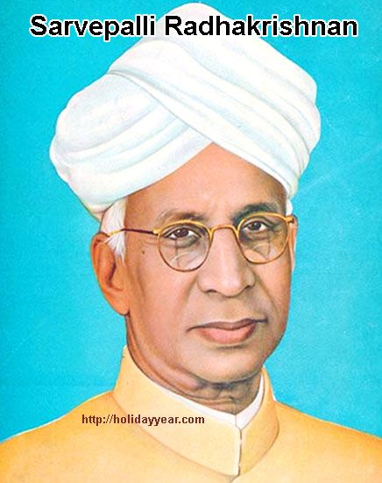
lhf;lh;. ,uhjhfpU\;zd;

Slide 25
Neh;kiw kdg;ghd;ikapd; ed;ikfs; (Benefits of Positive Attitude)
rpf;fy;fisj; jPh;f;fpwJ (Solves Problems)
tpRthrj;ij tsh;f;fpwJ (Breeds Loyalty)
FO Ntiyfis tsh;f;fpwJ (Cultivates team work)
MNuhf;fpakhd #oiy cUthf;FfpwJ (Makes Healthy Atmospheres)
kd mOj;jj;ij Fiwf;fpwJ (Reduce Stress)
kfpo;r;rpahd MSik cUthfpwJ (Develops Pleasing Personality)

Slide 26
7. khpahijia typAWj;Jjy; (Insist on Respect)
gpwiu kjpj;jy;
Rakhpahijiag; ghJfhj;jy;
midtiuAk; fz;zpaj;JlDk;, khpahijAlDk; elj;Jjy;
nfhLik kw;Wk; gpwiu jhf;Fjy; ,tw;iw vjph;j;jy;
J\;gpuNahfk; kw;Wk; tpjpia kPWjiy mDkjpf;fhjpUj;jy;.

Slide 27
8. cly; nkhopapd; ntspg;ghL (Body Language)
cly; mirTfspd; ntspg;ghL; Kf;fpakhdJ
vt;thW cl;fhu Ntz;Lk;
vt;thW elj;jy; Ntz;Lk;
vt;thW rhg;gpl Ntz;Lk;
Mfpa cly; nkhopia Mrphpah; fw;Wj;jUjy;.

Slide 28
9. jd;dhh;tj;njhz;L (Volunteerism)
jd;dhh;tj;jpd; Kf;fpaj;Jtj;ij ciuj;jpLjy;;
jd;dhh;tj; jpl;lq;fis cUthf;fp, gq;Nfw;f Cf;Ftpj;jy;
Ma;tfk;, Njhl;lq;fs;, ed;nfhilfis Nrfhpj;jy; Mfpatw;wpy; mDkjpj;jy;
cly; CdKw;Nwhh; kw;Wk; tajhdth;fSf;F cjtpl Cf;FtpAq;fs;.
MNuhf;fpakhd gof;ftof;fq;fis filg;gpbf;f cjTjy;
Rw;Wr;#oiy ghJfhj;jply;

Slide 29
10. ek;gfj;jd;ik (Authenticity)
khzth;fsplk; cs;s jdpj;jd;ikf;F kjpg;gspj;jy;.
jdpj;jd;ikia Fiw $wf;$lhJ.
jdpj;jd;ikNahL ,Ue;jhy;jhd; jdJ jpikia tsh;j;Jf;nfhz;L rpwg;gilthh;fs;.

Slide 30
11. Mil czh;T (Dressing Sense)
Ms; ghjp, Mil ghjp vd;gJ gonkhop
gpwh; kjpf;fj;jf;f tifapy; cil mzpa Nghjpj;jy;

Slide 31
12. nray;fs; NgRfpd;wd (Actions Speak)
fw;wYk;, mwpTk; rhpahfg; gad;gl cjTjy;
Mf;fG+h;tkhd nray;fis Mjhpj;jy;
nray;ghl;bw;fhd jpl;lkpliy tsh;j;jy;
ngw;Nwhh;fs; gps;isfis Cf;Ftpf;f mwpTWj;jy;

Slide 32
13. milnkhopiaj; jtph;f;fTk; (Avoid Labels)
Njhw;wk;, xU gof;fk; my;yJ xU tp\aj;Jld; Kj;jpiu Fj;JtJ
,J vjph;kiw kdg;ghd;ikia tsh;f;Fk;
Fz;L, Nrhk;Ngwp, jj;jp, Kl;lhs;, $Kl;il thh;j;ijfis jtph;j;jy;.
,jdhy; rpejidapd; nrayhf;fk; ghjpf;fg;gLjy;
,d;ndhUtUld; xg;gpLtijj; jtph;j;jy;
jq;fs; nrhe;j jpwidAk;, MSikiaAk; ntspg;gLj;j cjTjy;

Slide 33
14. NfSq;fs; (Listen)
jdpg;gl;l fUj;Jf;fis; mf;fiwAld; Nfl;ly;
vy;NyhUf;Fk; xNu khjphpahd ftdk; nrYj;jy;
ek;gpf;ifia mjpfhpj;jy;
Neh;kiwahd czh;tpidf; nfhLj;jy;
MSikfspy; ek;gpf;ifia tsh;j;jy;

Slide 34
15. md;gpdhy; jpUj;Jq;fs; (Punish Lovingly)
td;Kiw kw;Wk; J\;gpuNahfk; nra;ahjpUj;jy;
jtiw md;ghf vLj;Jf;$Wjy;
vJ rhp vJ jtW vd;gij Ghpe;J nfhs;sr; nra;jy;
xg;gjy; mspf;fhjjw;fhd fhuzq;fis tpsf;Fjy;
kd Vkhw;wk; milahj tifapy;; vLj;Jiuj;jy;

Slide 35
16. mth;fSf;F cjTq;fs; (Help Them)
Foe;ijg; gUtk; epiwa fw;wy; tha;e;jJ
tpiuthd khw;wq;fis cs;slf;fpaJ
cjtp Njitg;gLk; nghOnjy;yhk;, cldpUe;J cjTjy;
,Wjptiu MjuT mspj;jy;
kd typik, Kd;Ndw;wk; kw;Wk; ntw;wpaila topfhl;Ljy;

Slide 36
17. cly; MNuhf;fpak; (Health)
jpdKk; mjpf jz;zPh; mUe;jTk;
uh[hitg; Nghd;w fhiy czT,
,sturd; Nghd;w kjpa czT,
gpr;irf;fhud; Nghd;w ,uT czT
kuk; kw;Wk; nrbfspy; tsUk; czTfis mjpfk; rhg;gpLq;fs;
Mw;wy;, cw;rhfk; kw;Wk; mDjhgk; ,tw;Wld; thOq;fs;.

Slide 37
18. ftiyg;gLtij epWj;Jq;fs;! thoj; Jtq;Fq;fs;;! (Stop Worrying! Start Living)
vjph;fhyj;ijg; gw;wp ftiy nfhs;shjpUj;jy;;
epfo; fhyj;ij re;Njh\khf thoj; Jtq;Fjy;
Nkhrkhd .#o;epiyapid kdhPjpahf Vw;Wf;nfhs;sy;
gpur;rpid jPutpy;iyah?
ftiyg;gLtjhy; kl;Lk; xU gpur;rpid jPh;e;J tpLkh?
ftiyiaj; Jhf;fp vwpjy;;

Slide 38
19. rpwe;j MSikAilatuhf rpy MNyhridfs; (How to make Good Personality)
vq;Nf vg;NghJ, vg;gb NgRjy;Ntz;Lk;
cuf;f NgRtij jtph;j;jy;
gpwUld; NgRtjw;F jaf;fk; fhl;lhjpUj;jy;
MSik vd;gJ Gw mofpy; ,y;iy vd;gij epidtpy; nfhs;sy;
ghpTilatuhfTk;, md;G epiwe;jtuhfTk; ,Uj;jy;;
mikjpahfTk;, Gj;jprhypj;jdj;NjhLk; ,Uj;jy;;
Kul;Lj;jdkpf;ftuhfTk;, mjpf $r;rypLgtuhftk; ,Uj;jy; $lhJ
cq;fis ePq;fNs re;Njfpf;fhjpUj;jy;
cq;fs; cilapy; ftdk; nrYj;Jjy;;
cq;fSf;nfd jdpg;gl;l ghzpia cUthf;fpf; nfhs;sy;;
Nghyr;nra;ahjpUj;jy;

Slide 39
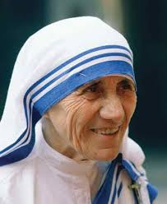
m
md;id njurh

Slide 40
20. ntw;wpahsh;fs; vt;thW Njhy;tpahsh;fsplkpUe;J NtWgLfpwhh;fs; (How winners are different from losers)
fbd ciog;G kw;Wk; epiyahd jd;ik (Hard work and Consistency)
Neh;kiwahd kdg;ghd;ik ( Positive attitude)
tplh Kaw;rp (Keep trying)
ftdk; kw;Wk; cWjpg;ghL (Focus and Determination)
Kiwahd jpl;lkply; kw;Wk; nray;ghL (Strategic planning and deliverance)
jd;dk;gpf;if (Self-confidence)
Neu Nkyhz;ik (Time management)
nray;gLj;Jk; Kiw (Practical)
Neh;kiwahd rpe;jid (Positive Thinking)

Slide 41
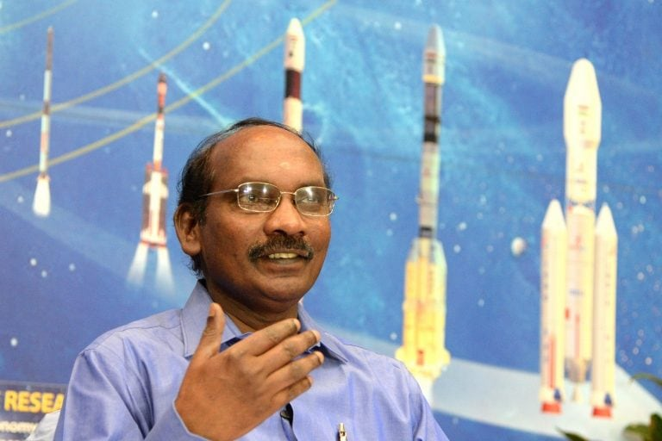
rptd; (,];Nuh jiyth;)

Slide 42
Be SLIM No FAT
F = Fear and Frustration - gak; kw;Wk; tpuf;jp
A = Anxiety and Anger - ftiy kw;Wk; Nfhgk;
T = Tension - gjw;wk;
S = Self – Confidence - jd;dk;gpf;if
L = Love - md;G
I = Initiative - Kaw;rp
M = Moderation - epjhdk;

Slide 43
Positive “WATCH”
W = Words - thh;j;ijfs;
A = Actions - nray;fs;
T = Thoughts - rpe;jidfs;
C = Characters - gz;Gfs;
H = Heart - md;ghd ,jak;

Slide 44
The Choice is Yours
“With a Bad Attitude
You Can Never have a Positive day”
“With a Positive Attitude
You Can never have a Bad day”

Slide 45
Neh;kiwahd kdg;ghd;ik cUthtjw;fhd topfs; (That is the Way to Positive Attitude)
Start the day with Love
Spend the day with Love
Fill the day with Love
End the day with Love

Slide 46
midtUf;Fk; kpf;f ed;wp
Kidth; j.rptrf;jp uh[k;khs;
cjtpg; Nguhrphpah;
fy;tp cstpay; Jiw
jkpo;ehL Mrphpah; fy;tpapay; gy;fiyf;fofk;
fhug;ghf;fk;, nrd;id – 97.

